Slide 1















EDA Project
IPL Analytics with eda
Name: Mahammed sabeer ali
Regno: 12200444
Course code: csm353

Slide 2





Introduction
The project, Exploratory Data Analysis (EDA) of IPL Matches (2008–2024), focuses on analyzing data from the Indian Premier League (IPL), one of the most celebrated T20 cricket tournaments worldwide. The goal of this analysis is to uncover insights into match outcomes, player and team performances, and trends over the years, providing value to teams, analysts, and fans alike.

Slide 3




Problem statement
Analyze IPL data from 2008 to 2024 to identify patterns in match outcomes, team and player performances, and derive insights for IPL teams, analysts, and fans.

Slide 4


Steps Taken to Solve
data collection
Data
Preparation
Cleaned data by handling null values in columns like Win_Type (replaced with 'No Result') and Win_Margin.
Created derived features such as Year from the Date column and Bat_First or Bowl_First based on the toss decision.
Source: The IPL dataset was collected from Kaggle, covering IPL matches from 2008 to 2024, and contains comprehensive data on team match-ups, venues, scores, toss outcomes, and player performances.

Slide 5


Methodology
Tools and Libraries: Pandas, NumPy, Matplotlib, Seaborn.
Data Cleaning: Handled null values, standardized team names, and extracted year information.
Analysis Techniques:
Univariate analysis: Histograms for scores and venue distributions.
Bivariate analysis: Correlation between toss decisions and match outcomes.
Multivariate analysis: Trends over years in scoring phases (powerplay, middle overs, death overs).

Slide 6
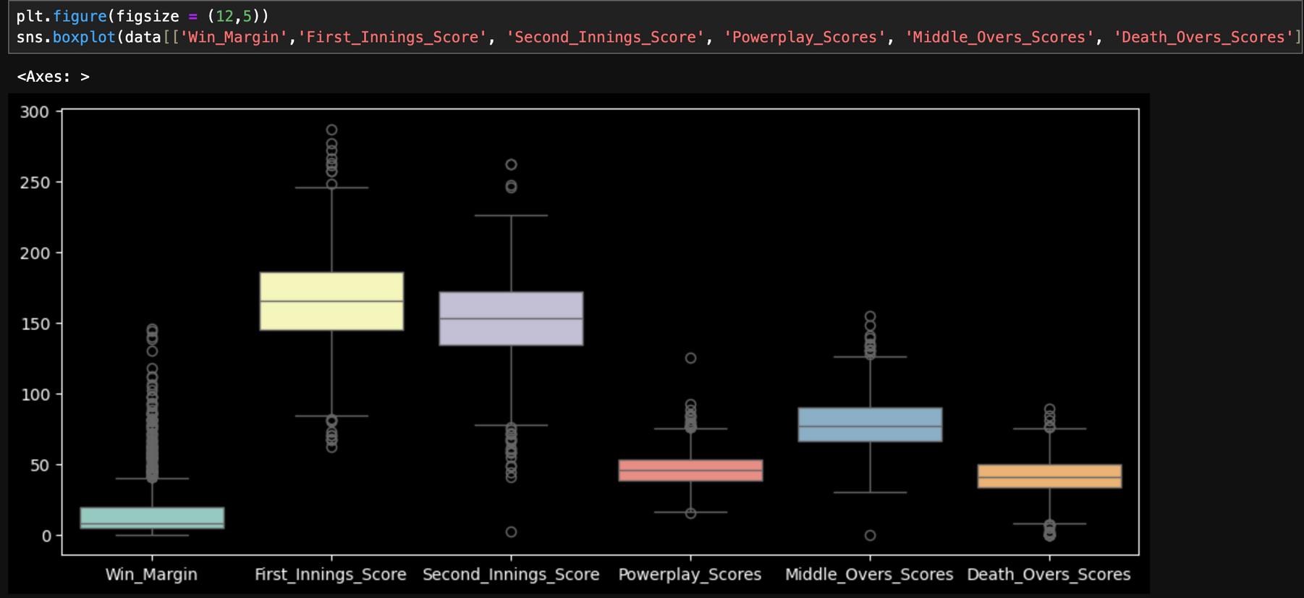
Outliers

Slide 7
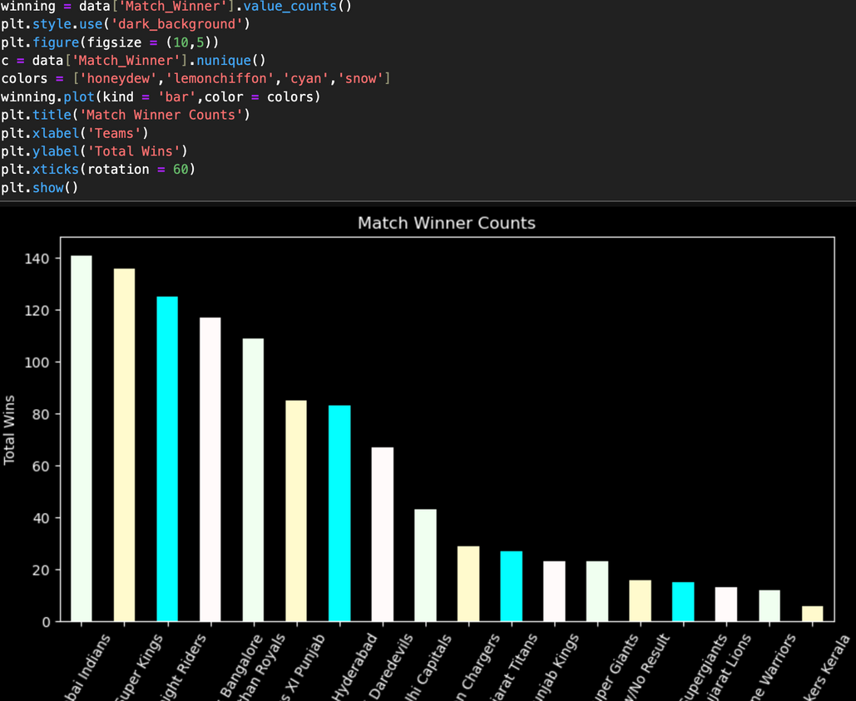
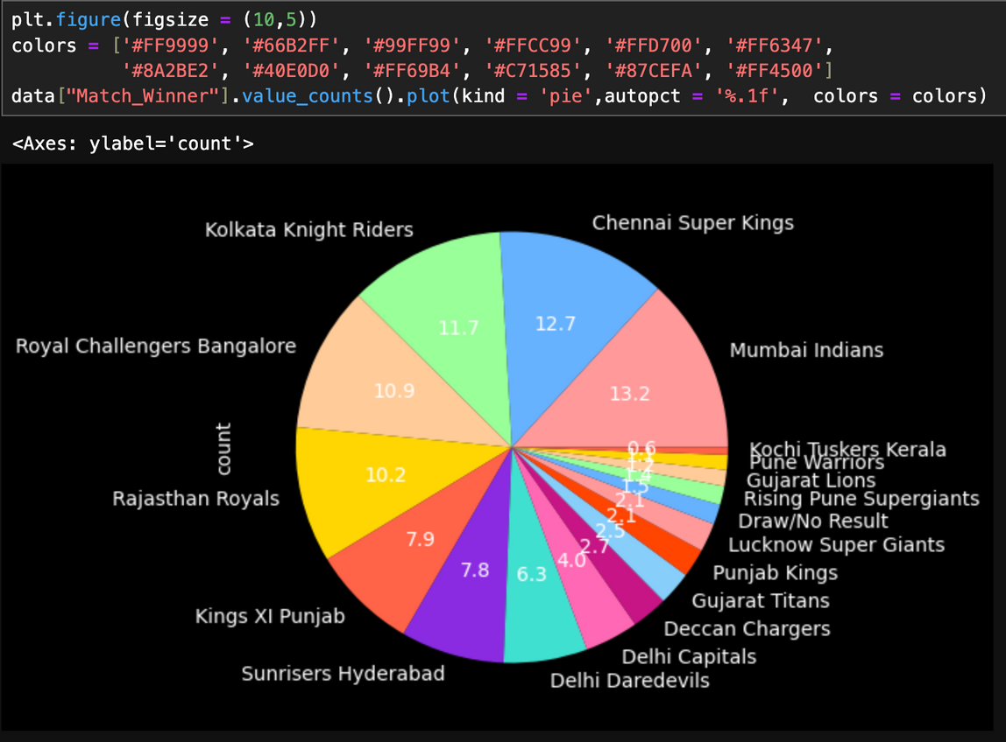
result & Analysis:
Univariate analysis
Plot a histogram showing the total number of match wins for each team.
Plotting a pie chart to show the percentage of total match wins by each team.

Slide 8
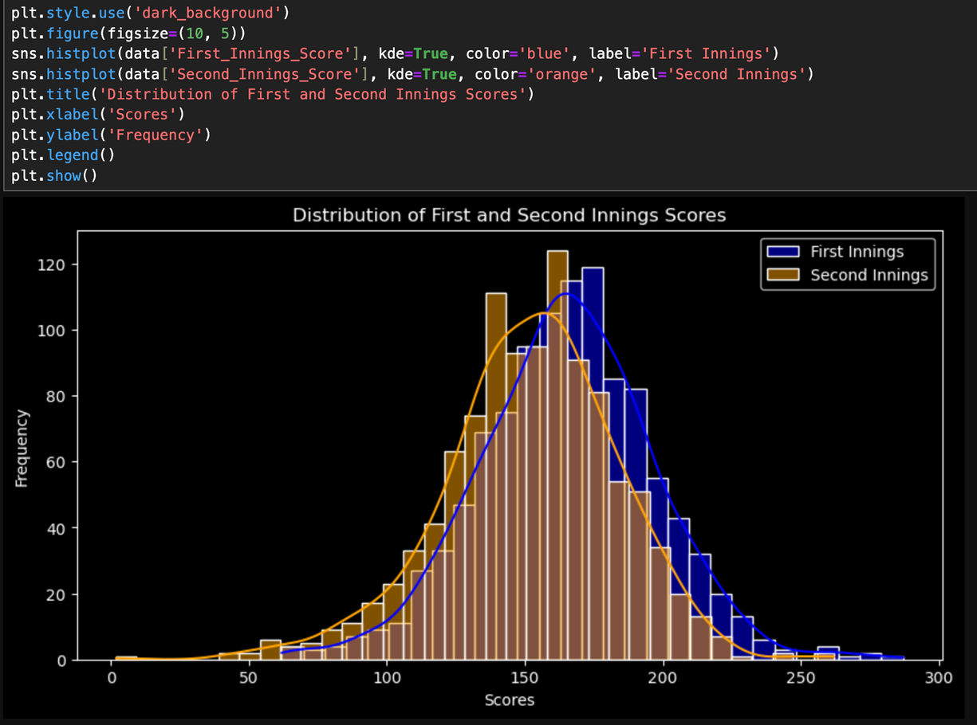
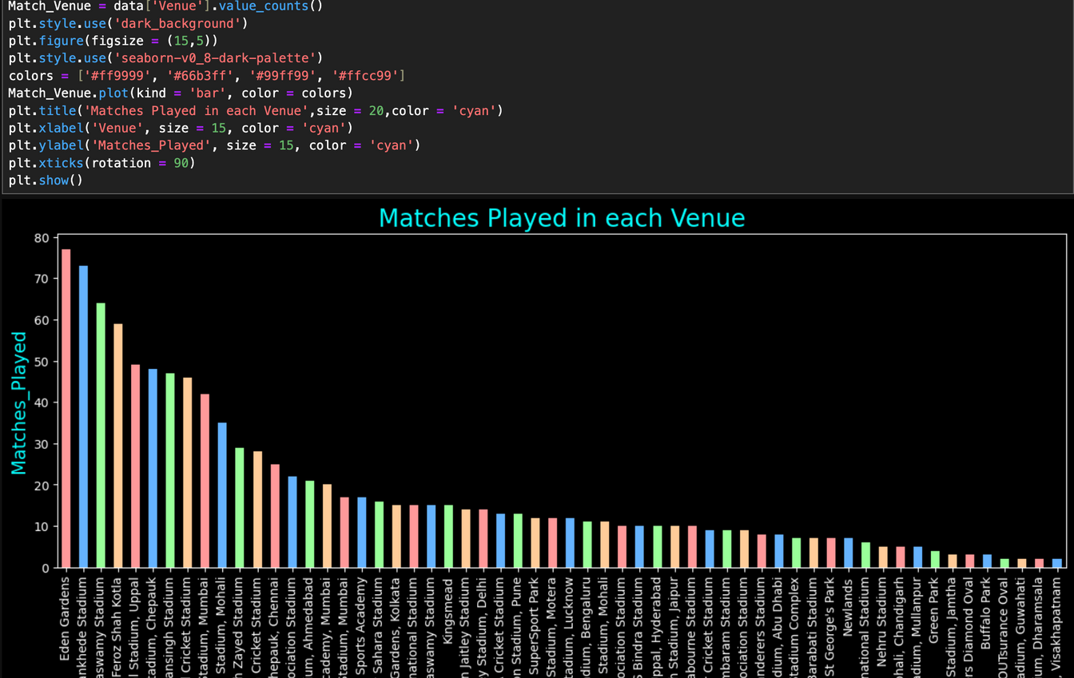
Univariate analysis
Plot a histogram with kde to show the distribution and frequency of the scores of first and second innings
Plotting a bar chart to show how many matches played in each venue

Slide 9
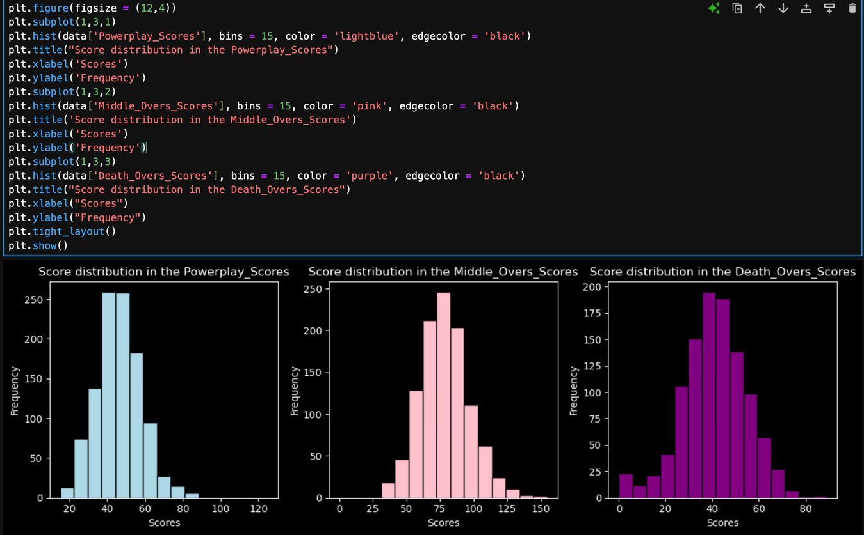
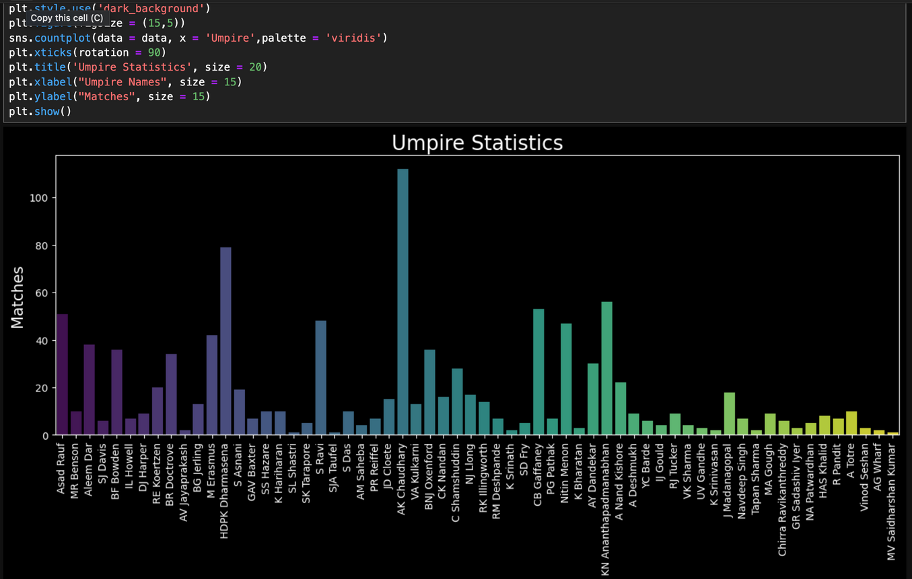
Univariate analysis
Plotting histogram subplots for the Powerplay_scores, Middle_over_scores, Death_overs_scores
Plotting a CountPlot for umpiring statistics.

Slide 10
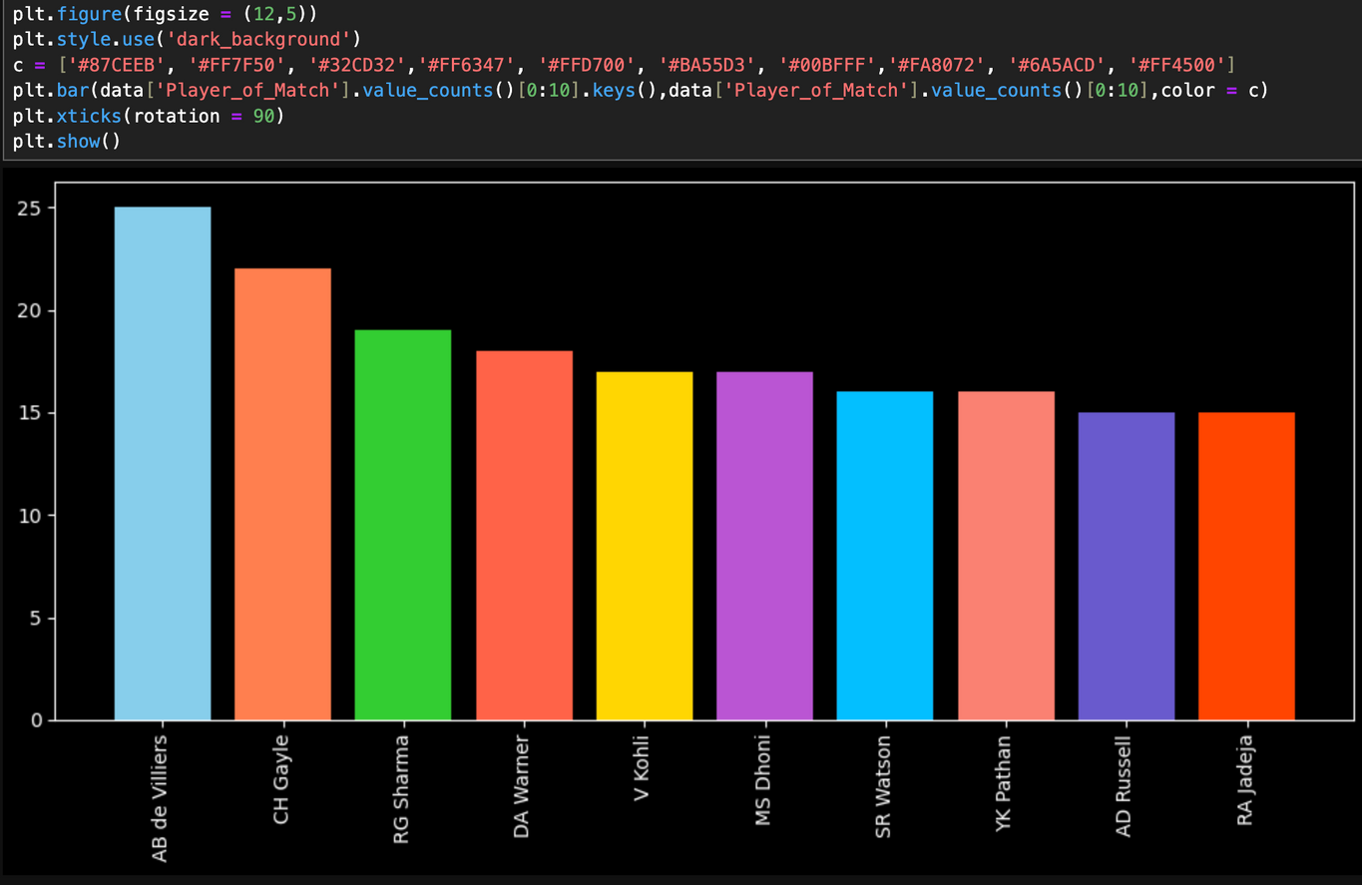
Univariate analysis
Plotting a bar graph showing the top 10 players with the most 'Player of the Match' awards.

Slide 11
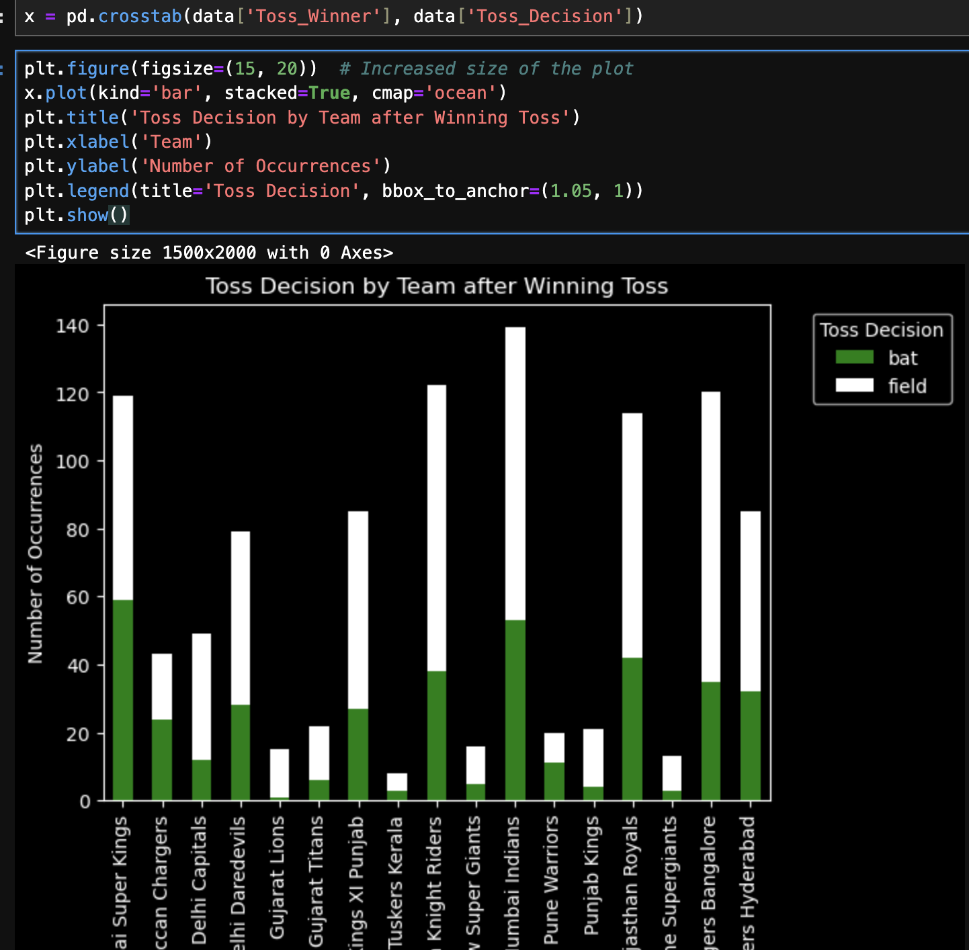
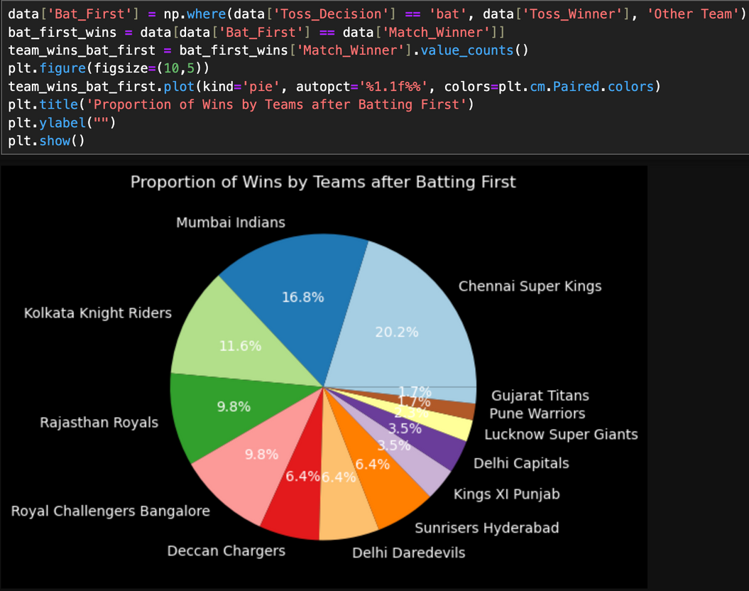
bivariate analysis
Plotting a Stacked Bar to show Which team has won the most tosses and what decision they make (Bat First or Bowl )
Plotting a piechart to find Proportion of Wins by Teams after Batting First

Slide 12
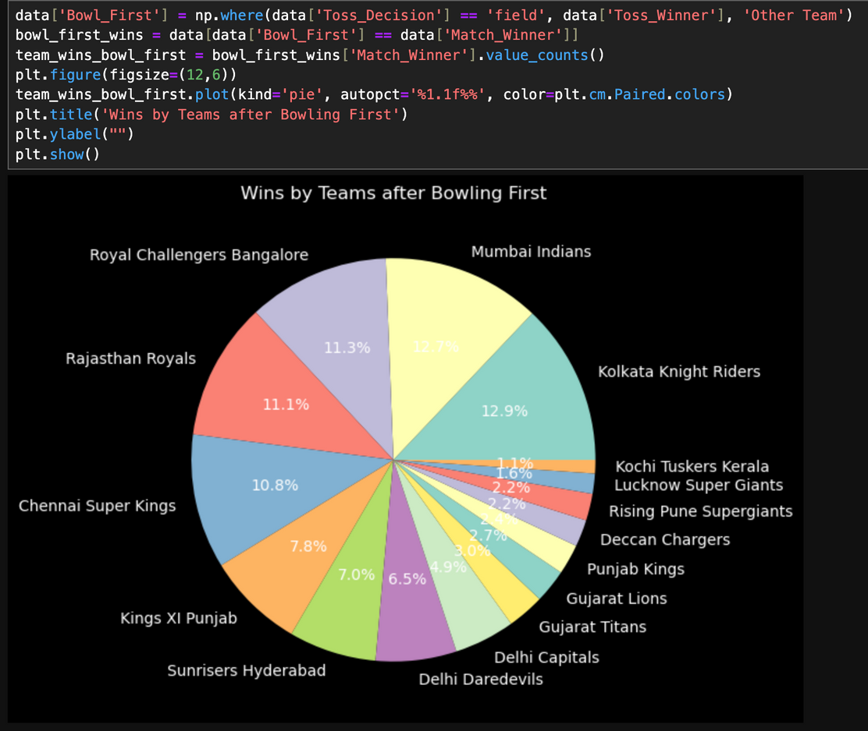
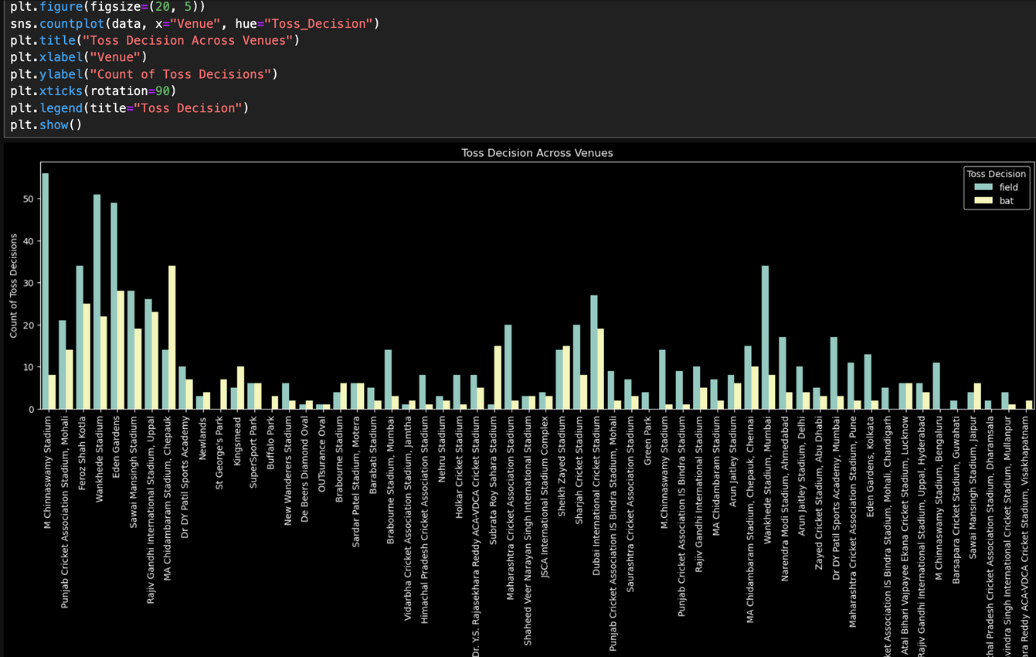
bivariate analysis
Plotting a piechart to find Proportion of Wins by Teams after Bowling First
Plotting a countplot to see the toss decisions on the different venues

Slide 13
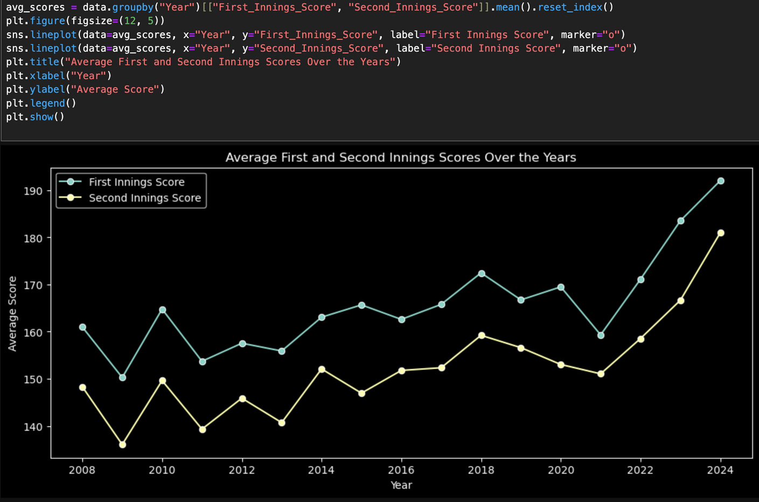
bivariate analysis
Plotting a line chart to see the average scores in the first and second innings over the years

Slide 14
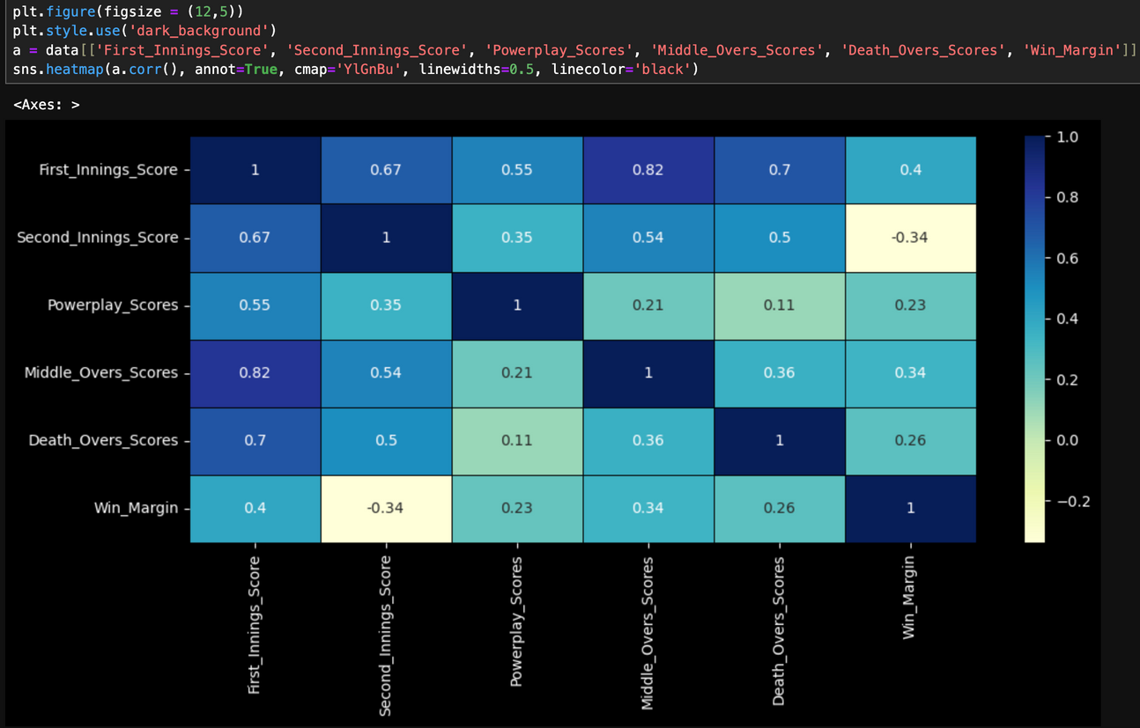
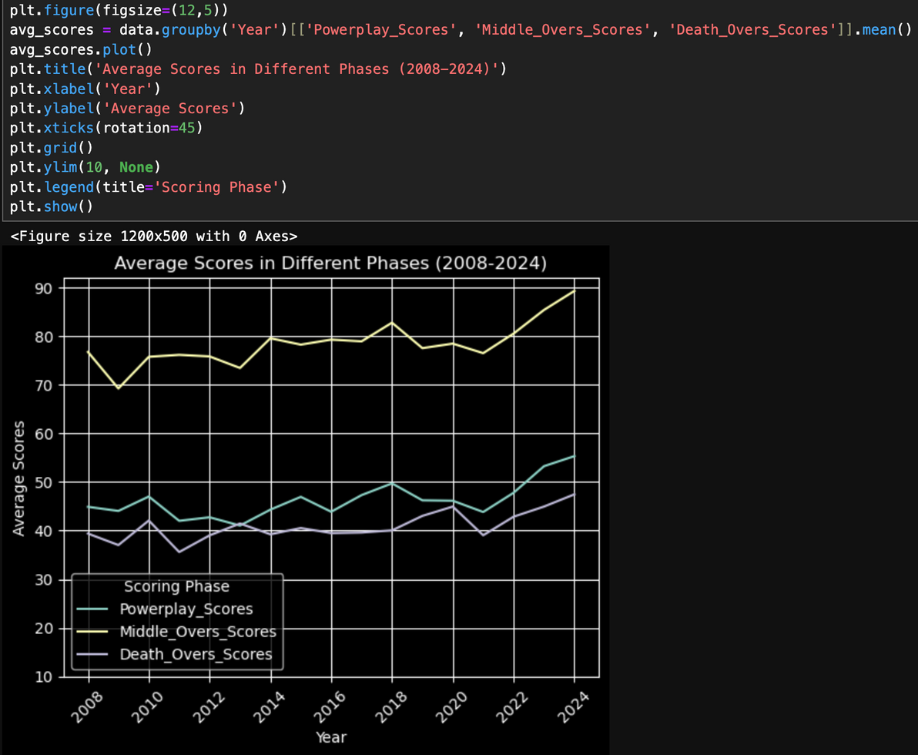
multivariate analysis
Plotting the Heatmap to find the correlation between the columns
plotting a line graph to show the avg scores in different phases

Slide 15
conclusion
This project studied IPL matches from 2008 to 2024 to find patterns in team and player performances, scoring trends, and match results. It showed how decisions like batting or fielding first and scoring in different phases affect the outcome. By using Python tools, the data was turned into easy-to-understand insights that can help teams plan better and fans enjoy the game more. The project shows how data can improve understanding of cricket and inspire more studies in sports analytics.

Slide 16
Reference
Data Source: Kaggle (https://www.kaggle.com/datasets/saiprudvirajy/indian-premier-league- ipl-2008-2024?select=team_performance_dataset_2008to2024.csv).
Libraries: Pandas, NumPy, Matplotlib, Seaborn.

Slide 17


Thank you very much!

